Slide 1

Tamagotchi Team 12
Kevin Alberto Falconett, Enrique Sanchez

Slide 2
What is it?
Our project is a representation based off the early 2000’s Tamagotchi pet.
A Tamagotchi pet is a virtual pet that was kept in a little device and displayed things such as the pet's happiness level, how hungry they were, their mood, etc.
These became very popular over the years and it was the user's responsibility to keep their pet alive and healthy. You could also log off the device, come back later, and the stats of the pet would have retro-actively updated depending on how much time you were gone.
This project mimics this technology.

Slide 3
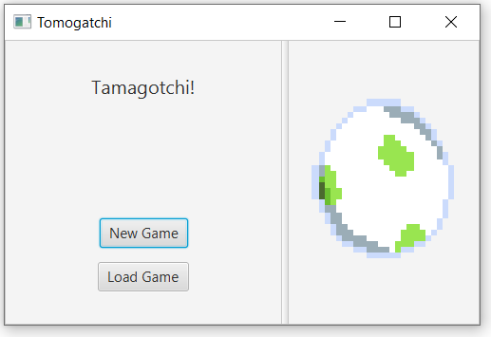
Opening screen
This is what it looks like when you run our Tamagotchi program from the Tamaclonchi.java file in the repository.
We have two features
New Game
Sends you to selection screen where you pick and set parameters for your pet
Load Game
Loads a pre-existing Tamagotchi pet file, that represents the name you inputted in the selection screen

Slide 4
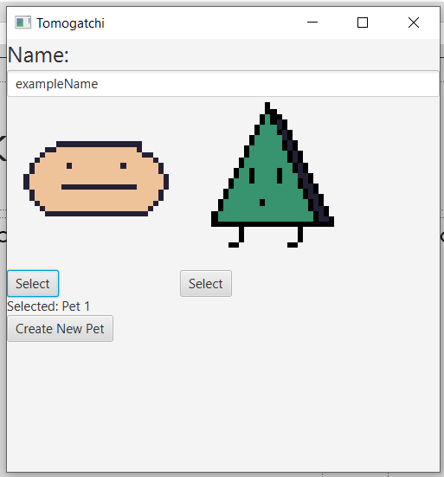
New Game screen
This is the new game screen
Features:
Name
Type in the name of your pet
Select between types
Choose either circle blob man or triangle cool guy (each have their own stats for their types, some have randomness involved but in a specific range for their type)
Create
Creates the pet with the fields you selected/inputted

Slide 5
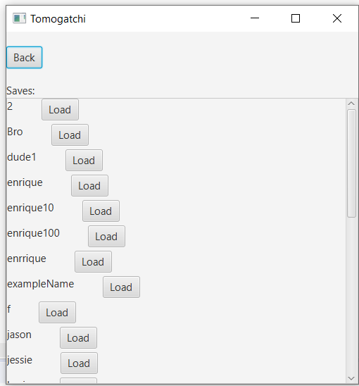
Load Game screen
This is the screen that pops up when the ‘Load Game’ button is clicked.
Features:
Provides a list of all the past and current Tamagotchi pets created.
As we see our exampleName from our last slide is created in the Load menu after we close our program and re-run it.
We can then select that file and it will load up the pet with its respective variables.

Slide 6
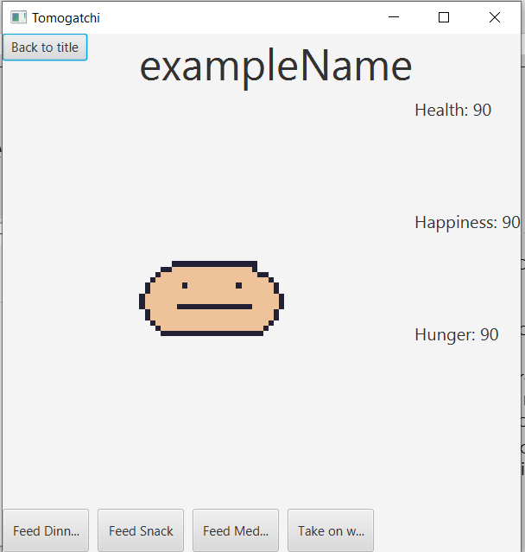
Play Screen
This is our Play screen where we interact with out Tamagotchi pet.
Features:
Back to title button
Feed Dinner
Adds 10 to the hunger
Adds 5 to the happiness
Feed Snack
Adds 5 to the hunger
Adds 10 to the happiness
Feed Medicine
Adds 10 to health
Take on walk
Adds 5 to health
Adds 10 to happiness
Subtract 10 from hunger

Slide 7
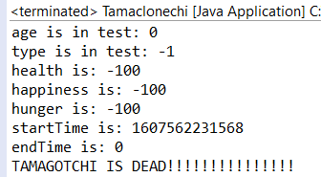
Dead Pet
If you try to Load a file with a Pet that has health less than 0 (health < 0), the program will close, and the current stats of the Tamagotchi will print out to the console and notify you that it is Dead.
Similarly if health ever hits less than 0 (health < 0) on the game screen, the program will do the same.

Slide 8
WOW Factors
We did multiple types and Auto-saving as our wow factors. Both of which have actually been displayed in the previous slides, however;
For reference, the top left picture represents the two types of pets we offer. Both of which have differing stats and decay rates.
The other picture shows the autosaving feature that happens whenever the program is closed (X on top right). The name of the pet inputted is what the file is saved under.

Slide 9

The End :D

